Slide 1
Conference Management System
By
Ahmed Adel
Emam Abdulaziz
Mohamed Saadedin
Mohamed Meshaal

Slide 2
Outlines
Introduction
History and Classical Ways
Conference Management Systems
Analysis and Design
Implementation
Website Screens
Live Demo

Slide 3

Introduction

Slide 4
Introduction
What is CMS?
A Conference Management System is web-based software that supports the organization of conferences.
The conference Admin, the Authors and the Reviewers in their respective activities.

Slide 5
Introduction
Why CMS?
Many academic conferences are held annually. This leads to a dramatic increase in the number of submitted papers, and substantial effort to manage these many submissions.

Slide 6

Historical and Classical ways

Slide 7
Historical and Classical ways
Wasting a lot of time on paper work.
Disconnection between the Authors and the Paper status.
No unified console to view and manage conferences.
Wasting time to transfer between the paper statuses (Submitted, being processed, under review,….. etc)

Slide 8

Conference Management Systems

Slide 9
Conference Management Systems
Management and monitoring of the program committee;
Sending emails to Reviewers, and authors;
Automatic paper submission;
Preparation of conference;
Online Paper Evaluation;
Monitoring papers status;
Electronically reviewers assignment

Slide 10

Conference Management Systems
Save Money
Save Time and effort
Great Value

Slide 11

Analysis and Design

Slide 12
Analysis and Design
CMS has three main functions:
Admin
Reviewers
Authors

Slide 13
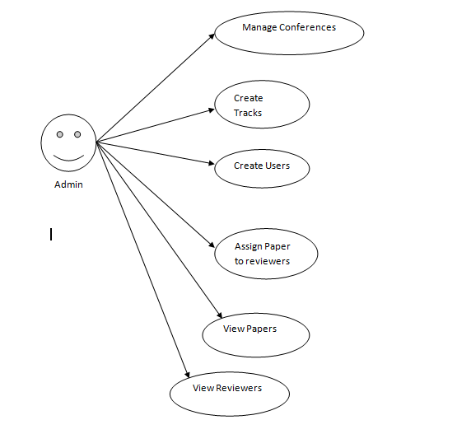
Analysis and Design

Slide 14
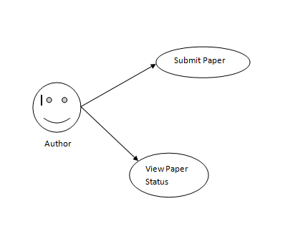
Analysis and Design

Slide 15
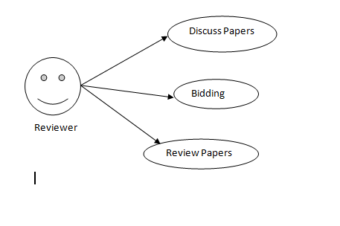
Analysis and Design

Slide 16
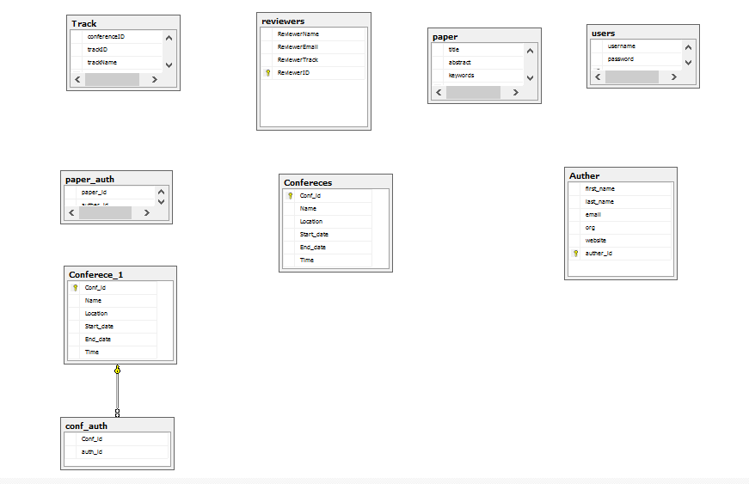
Analysis and Design
Database Structure ERD

Slide 17

Implementation

Slide 18
Implementation
Open source PHP programming language.
HTML
CSS
Java Script
Open Database Connection (ODBC)
Access Database

Slide 19
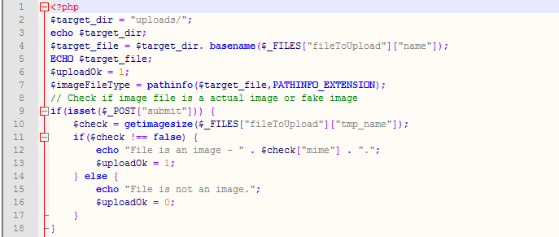
Implementation
PHP

Slide 20
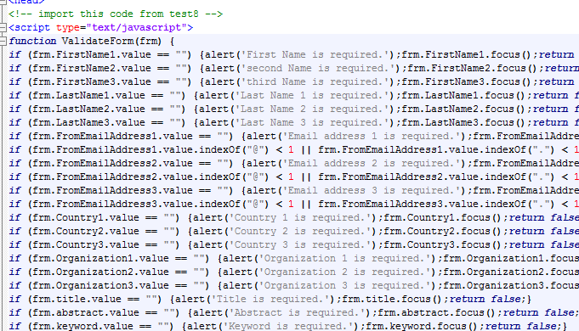
Implementation
Java Script

Slide 21

Implementation
ODBC

Slide 22
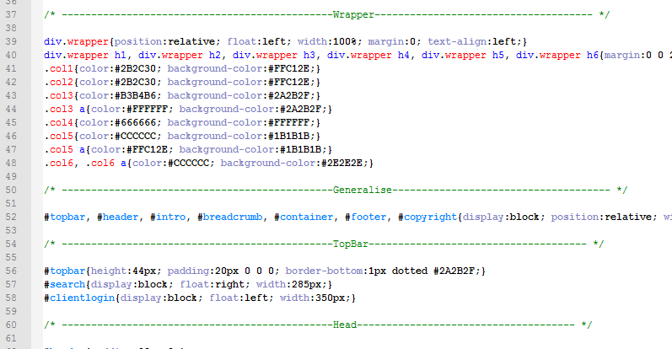
Implementation
CSS

Slide 23
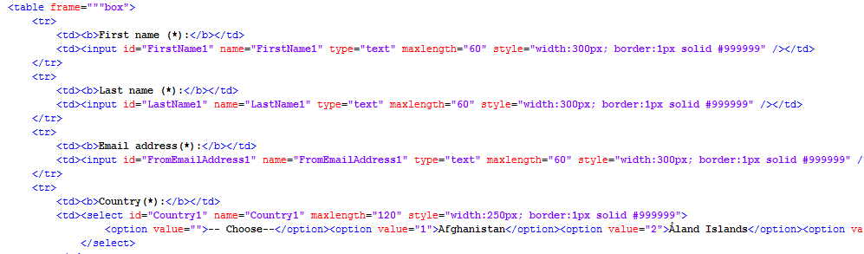
Implementation
HTML

Slide 24
Website Screens

Slide 25
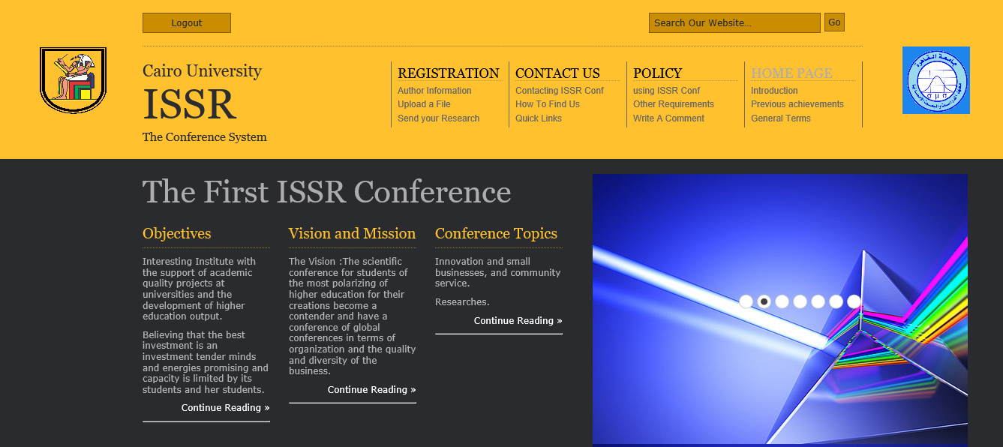
Website Screens
Home page

Slide 26
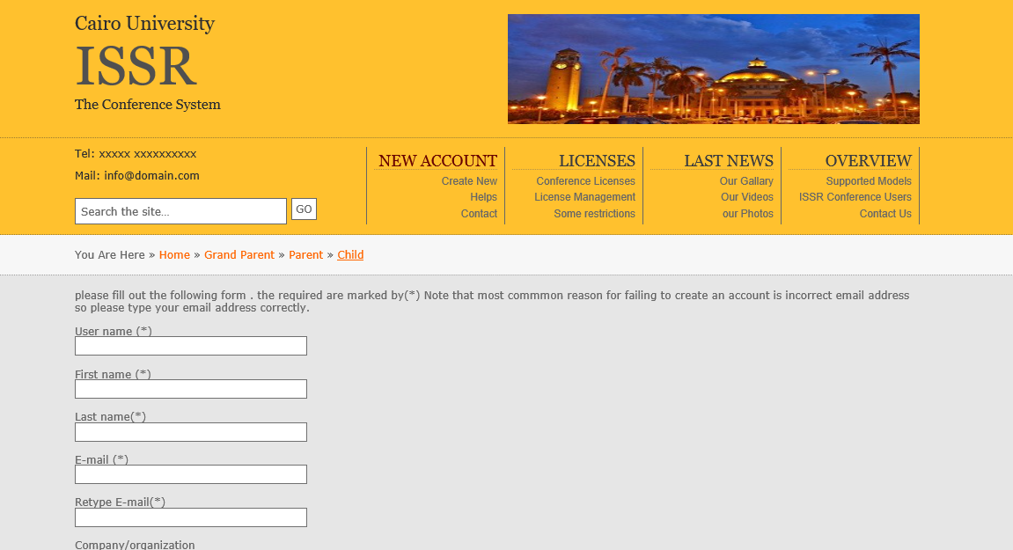
Website Screens
Create new user

Slide 27
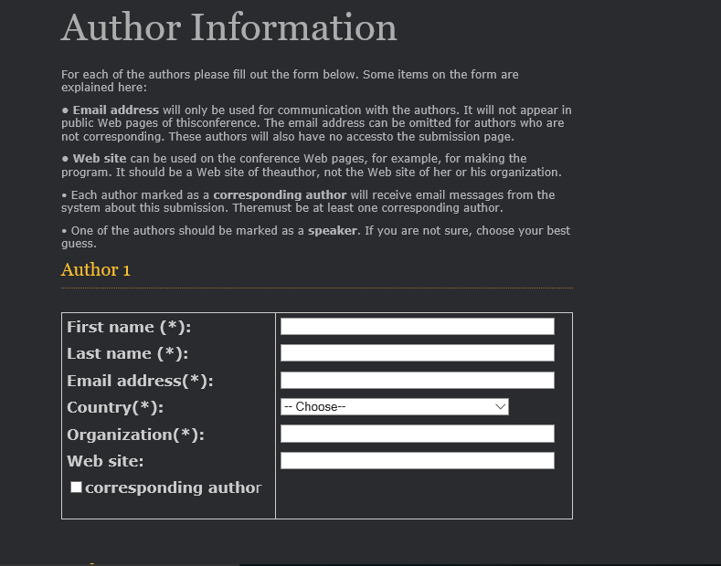
Website Screens
Author Registration

Slide 28
Live demo

Slide 29
Refereces
Designing an Online Conference Management System by Kevin Daimi and Luming Li
https://en.wikipedia.org/wiki/Abstract_management#Software
EasyChair.com

